Slide 1

Computer Virus

Slide 2
Content
What is Computer Virus
Types of Computer Virus
About Different types of Virus
Declined of Traditional Viruses
Actions to prevent virus infection

Slide 3

What is computer virus?
Computer virus refers to a program which damages computer systems and/or destroys or erases data files

Slide 4
Types of Computer Virus
Time Bomb
Logical Bomb
Macros Virus
Script Virus
Trojan Horse
Worms
Zombies

Slide 5
Types of Computer Virus
My Doom
Executable Virus
Boot Sector Virus
E-mail Virus
Melissa Virus

Slide 6

Time Bomb
A time bomb is a virus program that performs an activity on a particular date.

Slide 7

Logical Bomb
A logical bomb is a destructive program that performs an activity when a certain action has occurred.

Slide 8
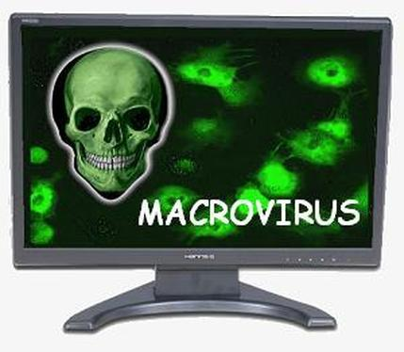
Macro Virus
A macro virus is associated with application software like word and excel. When opening the infected document, macro virus is loaded into main memory and destroys the data stored in hard disk

Slide 9

Script Virus
Commonly found script viruses are written using the Visual Basic Scripting edition (VBS) and the JavaScript programming languages

Slide 10
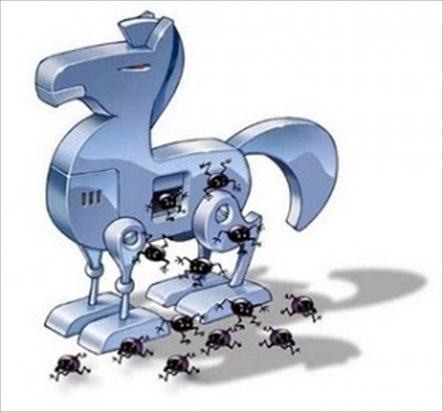
Trojan Horse
Trojan Horse is a destructive program. It usually pretends as computer games or application software. If executed, computer system will be damaged.

Slide 11
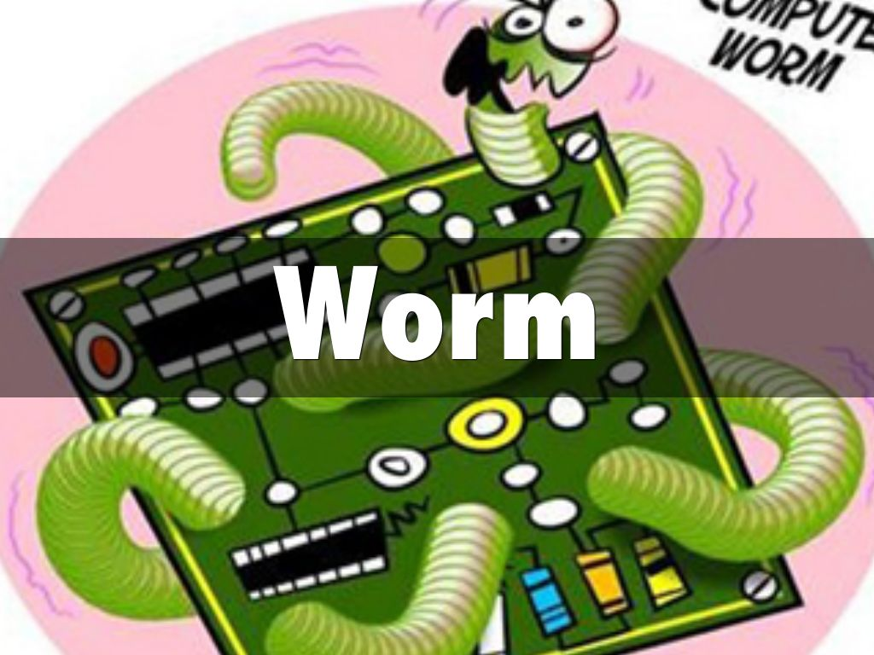
Worms
Worm - is a self-replicating program, similar to a computer virus. A virus attaches itself to, and becomes part of, another executable program; however, a worm is self-contained and does not need to be part of another program to propagate itself.

Slide 12

Zombies
Infected computers — mostly Windows machines — are now the major delivery method of spam.
Zombies have been used extensively to send e-mail spam; between 50% to 80% of all spam worldwide is now sent by zombie computers.

Slide 13
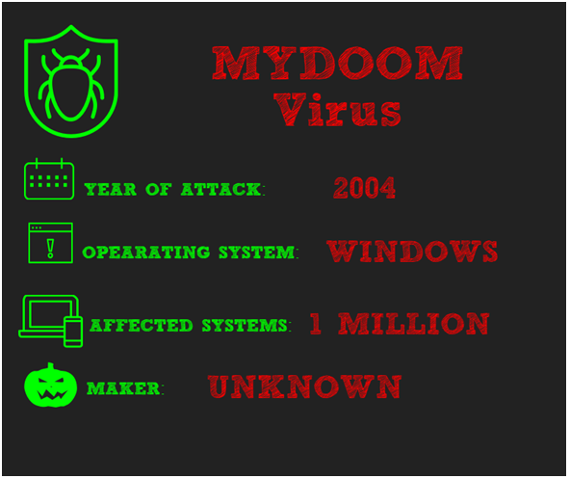
My Doom
26 January 2004: The My doom virus is first identified around 8am. Computer security companies report that My doom is responsible for approximately one in ten e-mail messages at this time. Slows overall internet performance by approximately ten percent and average web page load times by approximately fifty percent.

Slide 14
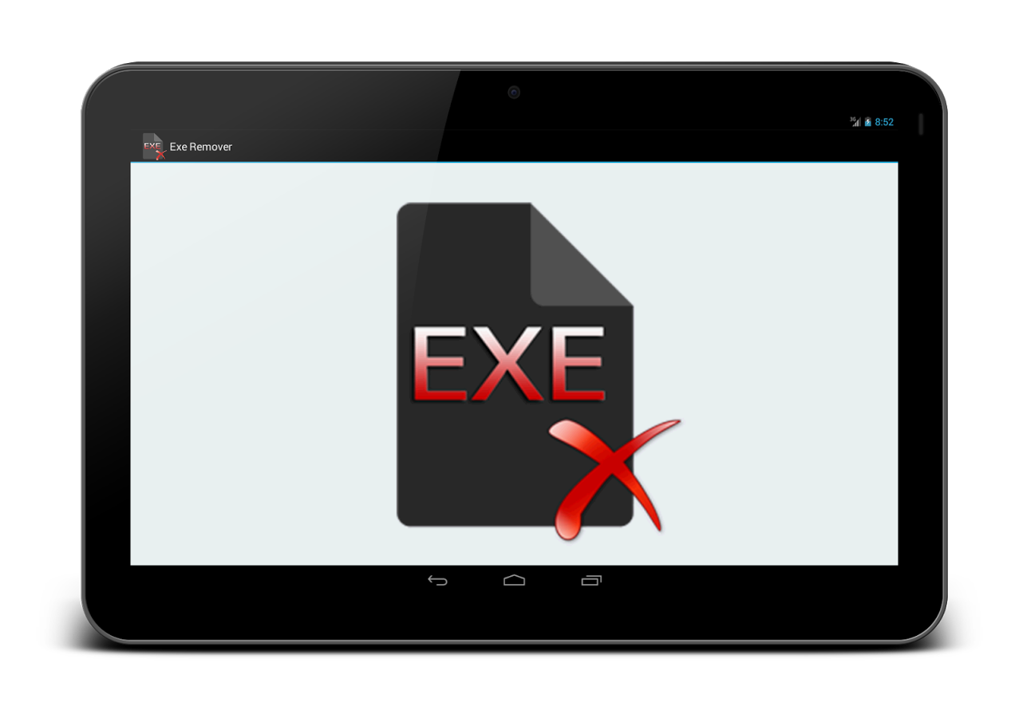
Executable Viruses
Traditional Viruses
pieces of code attached to a legitimate program
run when the legitimate program gets executed
loads itself into memory and looks around to see if it can find any other programs on the disk

Slide 15
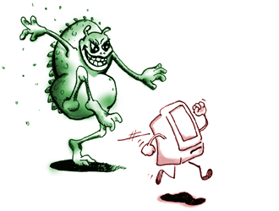
Boot Sector Viruses
Traditional Virus
infect the boot sector on floppy disks and hard disks
By putting its code in the boot sector, a virus can guarantee it gets executed
load itself into memory immediately, and it is able to run whenever the computer is on.

Slide 16

E-mail Viruses
Moves around in e-mail messages
Replicates itself by automatically mailing itself to dozens of people in the victim’s e-mail address book

Slide 17
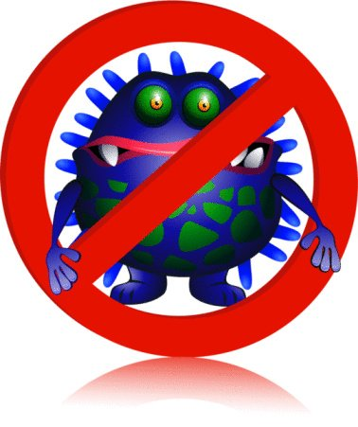
Melissa virus
the Melissa virus was the fastest-spreading virus ever seen
Someone created the virus as a Word document uploaded to an Internet newsgroup
People who downloaded the document and opened it would trigger the virus
The virus would then send the document in an e-mail message to the first 50 people in the person's address book

Slide 18
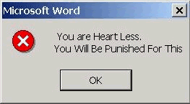
Typical things that some current Personal Computer (PC) viruses do
Display a message

Slide 19
Decline of traditional viruses
Reasons:
Huge size of today’s programs storing on a compact disk
Operating systems now protect the boot sector

Slide 20

Actions to prevent virus infection
Always update your anti-virus software at least weekly.
Back up your important files and ensure that they can be restored.
Change the computer's boot sequence to always start the PC from its hard drive

Slide 21
Actions to prevent virus infection
Don't share Drive C: without a password and without read-only restrictions.
Empty floppy drives of diskettes before turning on computers, especially laptops.

Slide 22
Actions to prevent virus infection
Forget opening unexpected e-mail attachments, even if they're from friends
Get trained on your computer's anti-virus software and use it.
Have multiple backups of important files. This lowers the chance that all are infected.

Slide 23
Actions to prevent virus infection
Install security updates for your operating system and programs as soon as possible.
Jump at the chance to learn more about your computer. This will help you spot viruses.

Slide 24
Credits
Tauseef Ansari SS15IF015
Sahil Sahikh SS15IF017
Taha Shaikh SS15IF012

